Slide 2


Sponsors: Global Azure 2023 – Toronto Edition
Adastra transforms businesses into digital leaders. Since 2000, Adastra has been helping global organizations accelerate innovation, improve operational excellence, and create unforgettable customer experiences, all with the power of their data. By providing industry-leading Artificial Intelligence, Cloud, Digital, and Governance services and solutions, Adastra helps enterprises leverage data that they can manage and trust, connecting them to their customers – and their customers to the world. We have a proven track record of delivering enterprise-grade solutions to Fortune 1000 and SME organizations across all industries. More information can be found at www.adastracorp.com.
We're a team of senior software developers who are experts in the Microsoft Azure Cloud. We partner with you to deliver innovative business solutions using Agile, CI / CD, DevOps & Software Automation. For more information, visit www.objectsharp.com

Slide 3
Architecting and building multitenant solutions in Azure
Callon Campbell
Microsoft MVP | Azure

Slide 4



About me
Callon Campbell
Consultant | Solution Architect | Developer
Microsoft MVP | Azure
5x Microsoft MVP in Azure
Consultant with Adastra specializing in App Migration, Modernization and an Azure Lead
20+ years in enterprise development with Microsoft technologies
Passionate about serverless and cloud-native application development
Speaker at community events and meetups
Blogging at https://TheFlyingMaverick.com
Organizer of “Canada’s Technology Triangle .NET User Group” in Kitchener, Ontario
Notes:
My name is Callon Campbell, I'm a 4 times Microsoft MVP in Azure. I’m also a consultant with Adastra specializing in App Migration, Modernization and an Azure Lead
I have 20+ years in enterprise development with Microsoft technologies focused on Azure, .NET, and SQL
I'm passionate about serverless and cloud-native application development and bringing those benefits to the enterprise.
I'm a speaker at local community events, meetups and Global Azure.

Slide 5
Agenda
Tenant isolation models
Deployment approaches
Data management
Elastic Database Client Library / SaaS app
Pool management
Demos throughout
Q&A

Slide 6
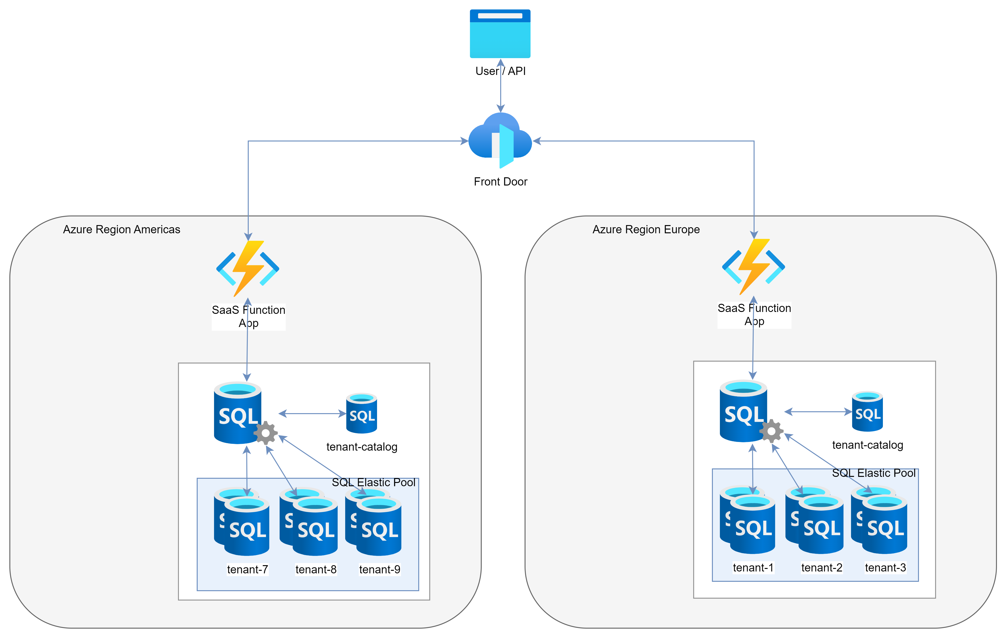
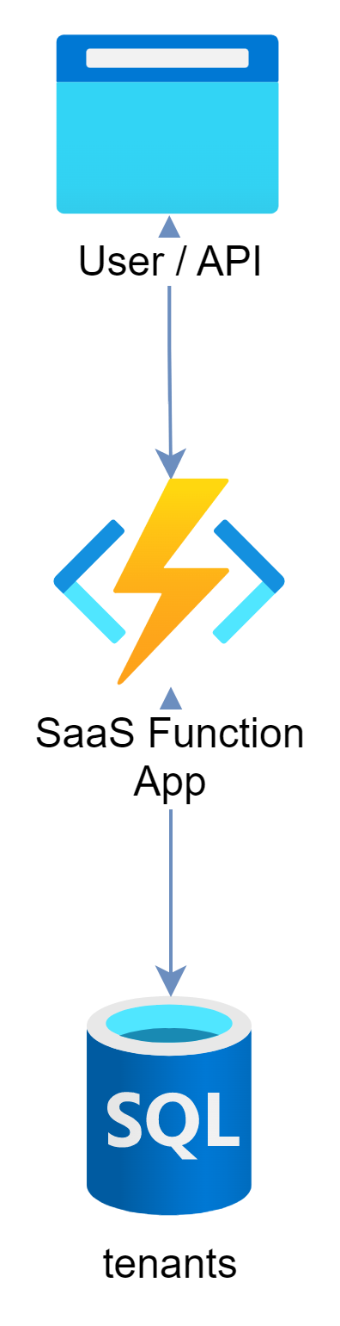
Current and target architectures
Notes:
So I want to set the context for this presentation and talk about how we can take an application running in a single region with single database that supports multitenancy and migrate that to support a sharded multitenancy design.

Slide 7
Tenant isolation

Slide 8
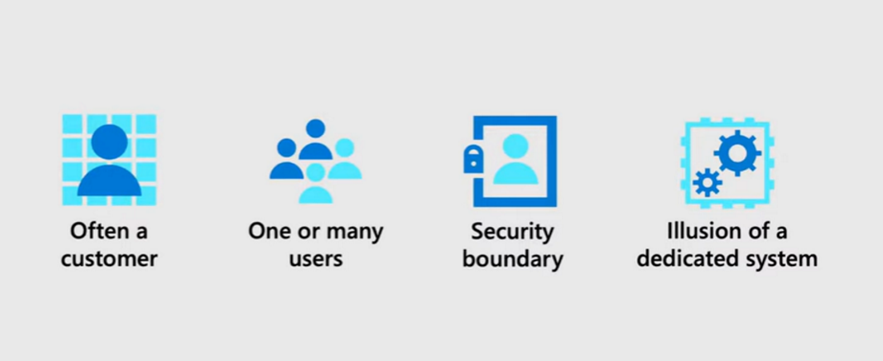
What is a tenant?
A software system that serves multiple tenants

Slide 9
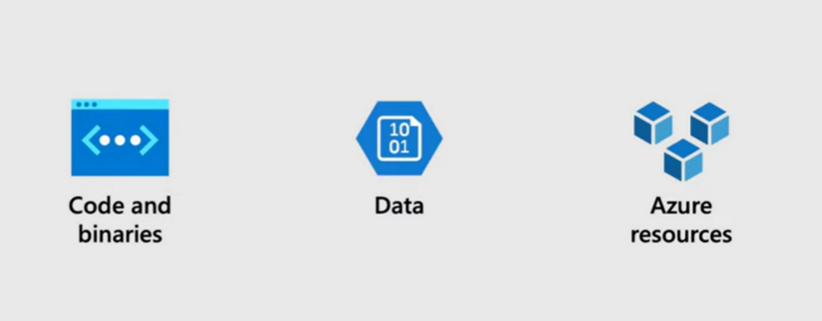
Tenant isolation

Slide 10
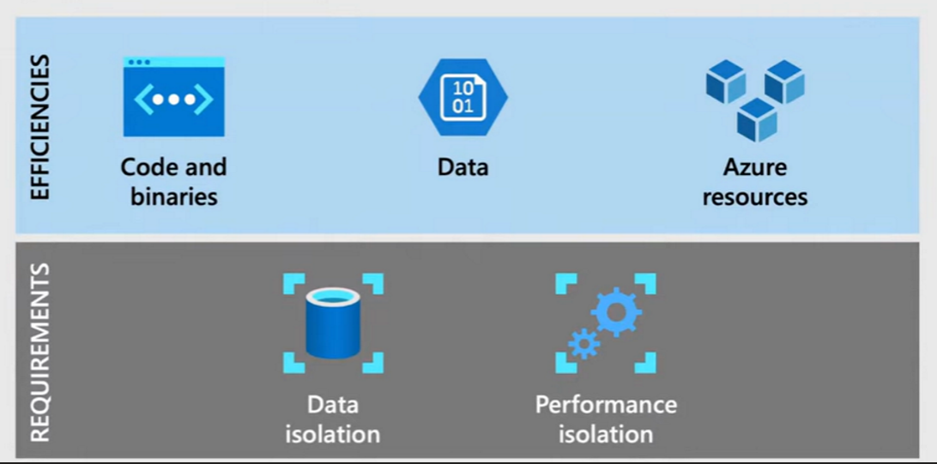
Tenant isolation

Slide 11
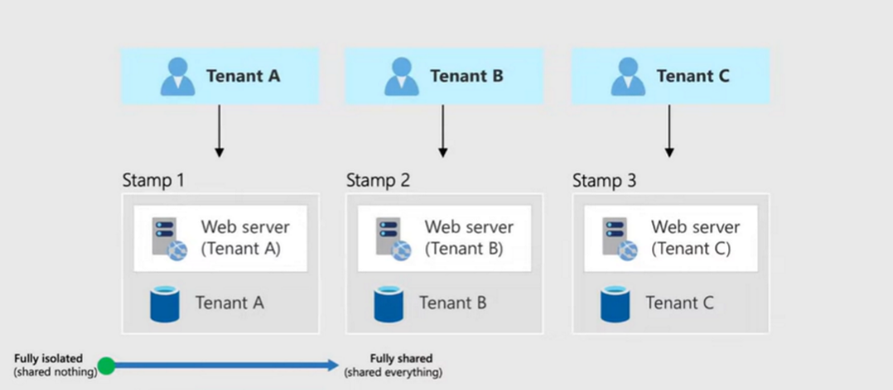
Tenant isolation models
Fully isolated deployments

Slide 12
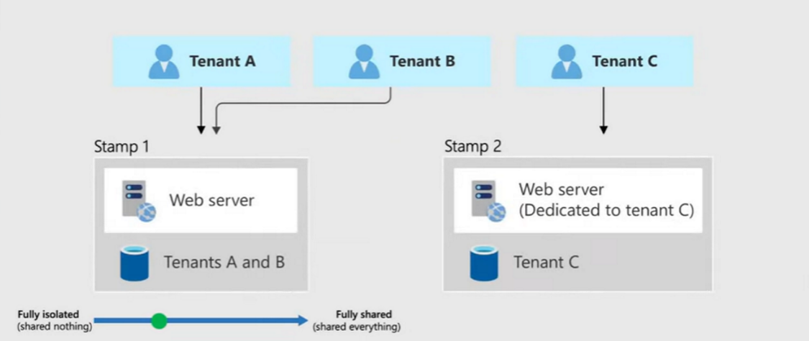
Tenant isolation models
Vertically partitioned deployments
Notes:
Tenant C is sensitive to performance
Tenant C might be in a different geographic region
Tenant C could be different price tier

Slide 13
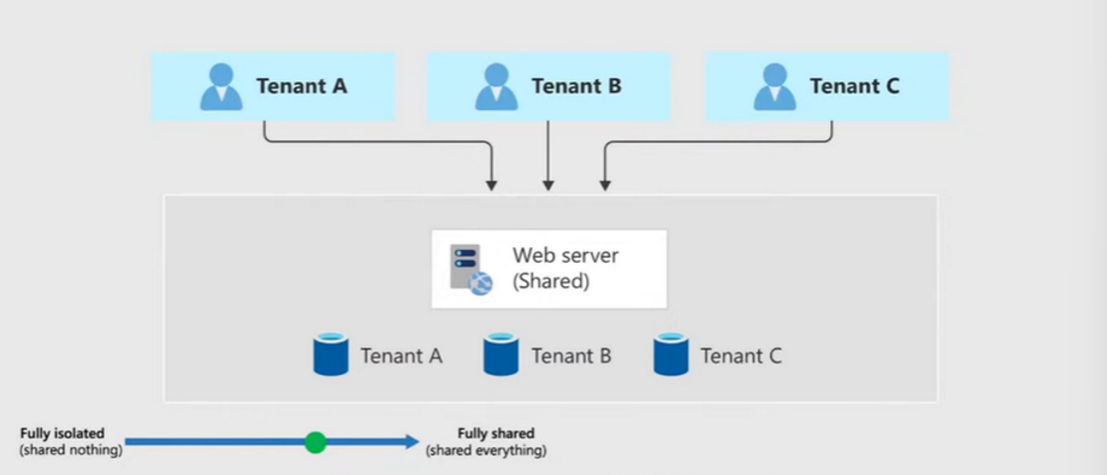
Tenant isolation models
Horizontally partitioned deployments

Slide 14
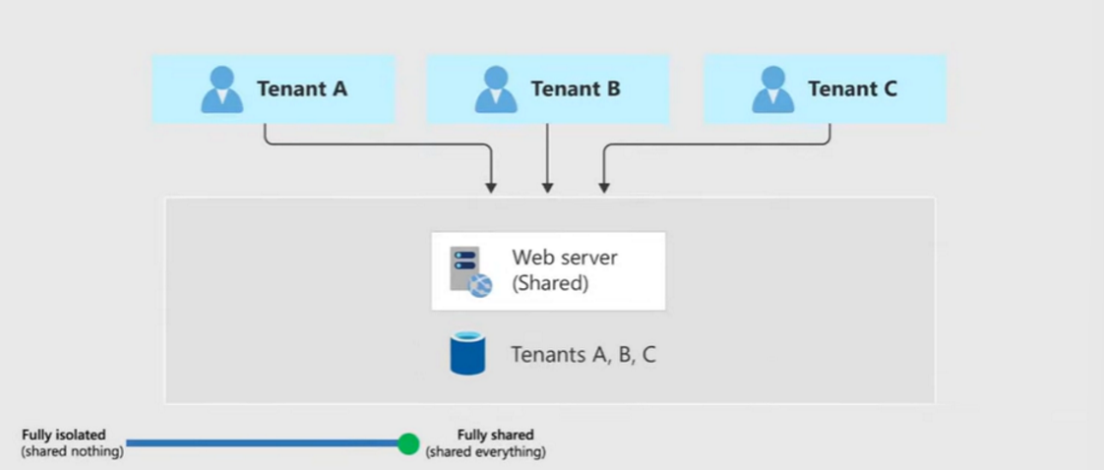
Tenant isolation models
Fully multitenant system

Slide 15
Deployment approaches

Slide 16
Onboarding and deployment
Plan the onboarding process
Consider automation requirements
Plan your deployment process
Plan your maintenance
What are your challenges?

Slide 17
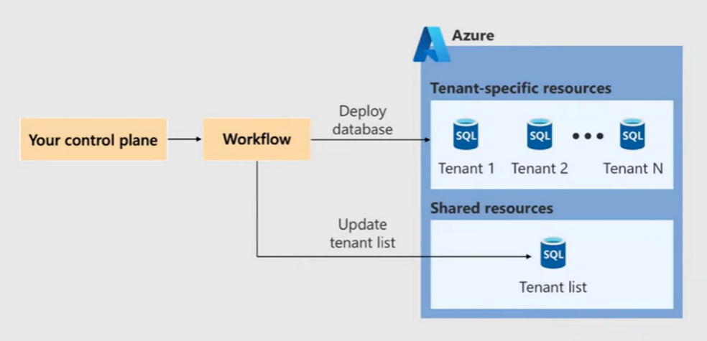
Deployment approaches
Control plane
Leverage your CI/CD (Azure DevOps, GitHub Action, etc) process
Workflow
Deploy database resources as IaC (Bicep / Terraform)
Deploy database schema
Update tenant list with tenant key and DB location in the catalog

Slide 18
Deployment workflow
Automate your control plane via CI/CD
Deploy DB schema
Deploy resources via IaC
Update tenant list
Bicep
SqlPackage.exe
Register database in tenant list (shard map manager)
Terraform
Dacpac / Bacpac
SQL script
Database restore

Slide 19
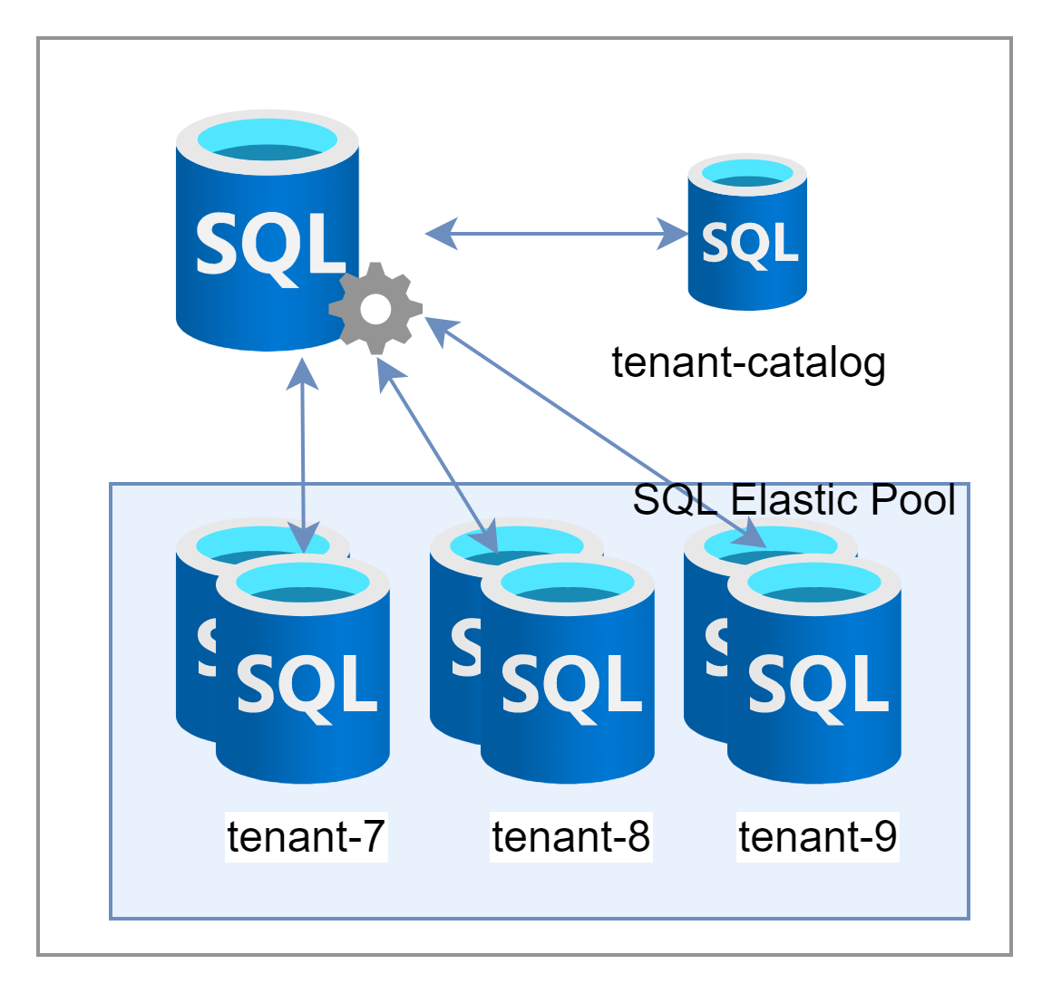
Our deployment scenario
SQL Server
SQL Elastic Pool
SQL Database(s)

Slide 20
DEMO: Deployment
Bicep IaC
Azure SQL, SQL Elastic Pools

Slide 21
Data management

Slide 22
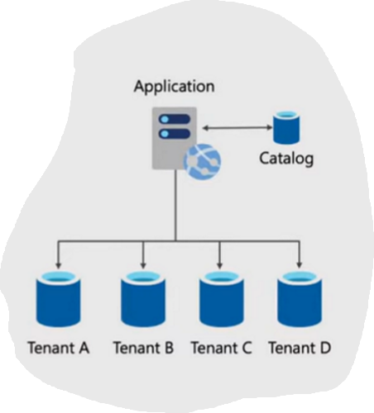
Single database per tenant
High scalability
Strong isolation
Simple per tenant data management
Can pool databases to share resources
Catalog database used to lookup tenant metadata

Slide 23
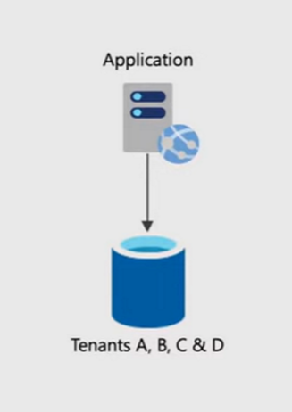
Single multitenant database
High tenant density (lower cost)
Lowest isolation
Susceptible to noisy neighbor issues
Per-tenant customization is a challenge
Management of a tenant data can be a challenge (ie. Restore a single tenant’s data)

Slide 24
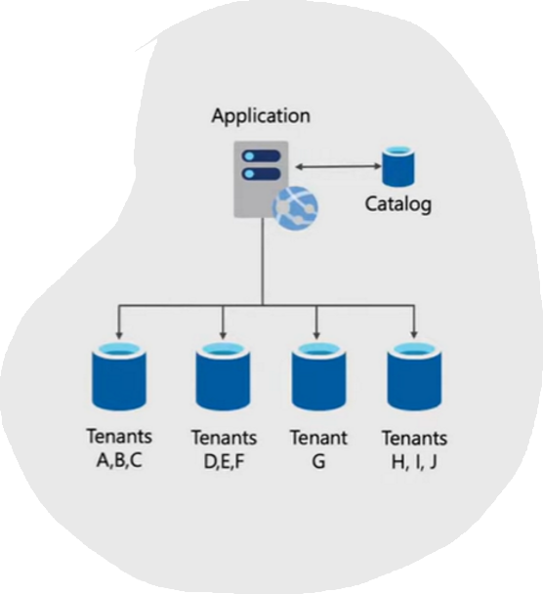
Sharded multitenant database
Hybrid of single database per tenant and single multitenant database
Tenants distributed across database (shards)
High scalability but susceptible to noisy neighbor issues
High tenant density
Lower isolation
Additional complexity

Slide 25
What is sharding?
Sharding makes the Database smaller
Sharding makes the Database faster
Sharding makes the Database much more easily manageable
Sharding can be a complex operation sometimes
Sharding reduces the transaction cost of the Database
Each shard reads and writes its own data
Failure of one shard doesn’t affect the data processing of other shards
Notes:
Sharding is a type of database partitioning that separates very large databases into smaller, faster, and more easily managed parts called data shards.
Each shard is held on a separate database server instance, to spread the load of queries across multiple resources.

Slide 26
Benefits to sharding
Improved scalability
Increased performance
Fault tolerance
Reduced costs
Notes:
Sharding allows the system to scale horizontally by adding more servers or nodes as the data grows. This improves the system’s capacity to handle large volumes of data and requests.
Sharding distributes the data across multiple servers or nodes, which improves the system’s performance by reducing the load on each server or node. This results in faster response times and better throughput.
Sharding provides a degree of fault tolerance as the system can continue to function even if one or more servers or nodes fail. This is because the data is replicated across multiple servers or nodes, and if one fails, the others can continue to serve the requests.
Sharding allows the system to scale horizontally, which can be more cost-effective than scaling vertically by upgrading hardware.

Slide 27
Elastic Database Client Library

Slide 28
What is the Elastic Database Client Library?
Create and manage scaled-out databases
Simplifies management tasks
Build sharded applications using 100’s or even 1000’s of databases in Azure SQL
Support for .NET and Java
Support for Entity Framework and Dapper
Split-merge tool for data movement
Notes:
Scaling out databases can be easily accomplished using scalable tools and features for Azure SQL Database.
EDCL let’s you:
Create and manage scaled-out databases
Simplifies management tasks for both developers and operations
Easily lets you develop sharded applications using 100’s or even 1000’s of databases in Azure SQL
Support for .NET and Java
Support for Entity Framework and Dapper
Split-merge tool for data movement

Slide 29
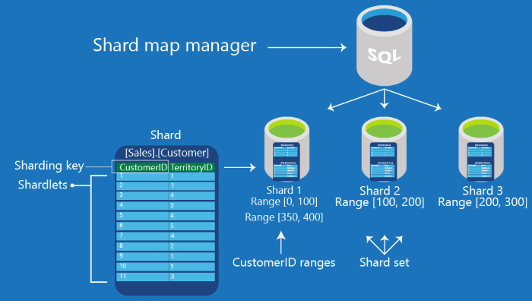
Sharp Map Manager
Special database that maintains global mapping about all shards (databases) in a shard set.
Metadata provides the connection details for the sharding key.

Slide 30
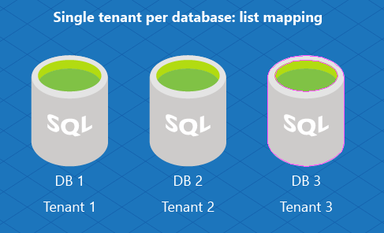
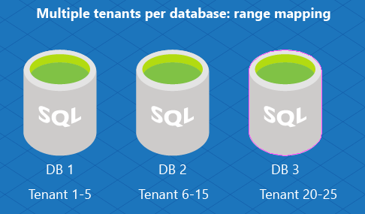
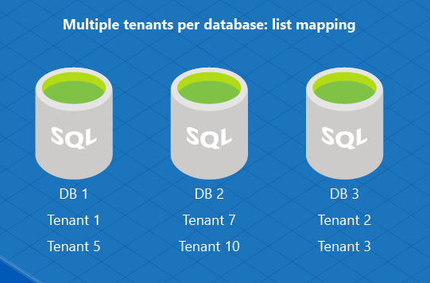
Shard maps and shard mappings
Each shard must select the type of shard map to create:
Single tenant per database
Multiple tenants per database (two types):
List mapping
Range mapping
For a single tenant model, use a list mapping shard map

Slide 31
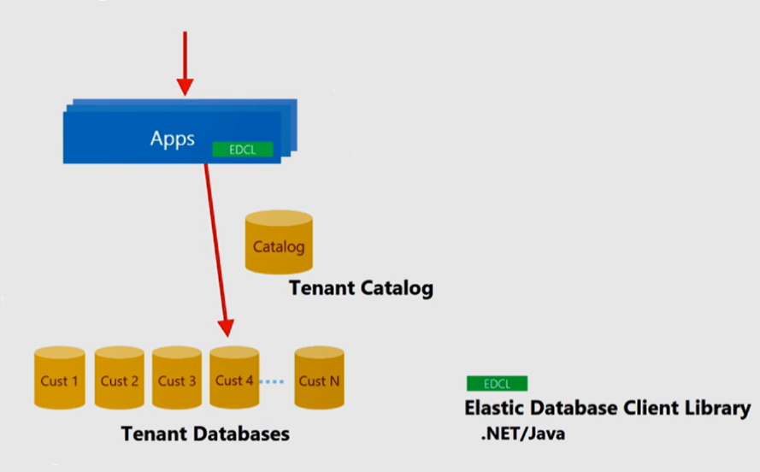
Application connection flow
Request comes into the app
App uses tenant key to get connection from tenant catalog (shard map manager)
App then connects to the correct tenant database
On subsequent requests, uses database location cached in EDCL

Slide 32
DEMO: Data management
Elastic Shard SQL Utility
Azure SQL, Elastic SQL Pools

Slide 33
DEMO: API SaaS app
Multi-tenant Function App
Azure SQL, Elastic SQL Pools, Elastic Database Client Library

Slide 34
Pool management

Slide 35
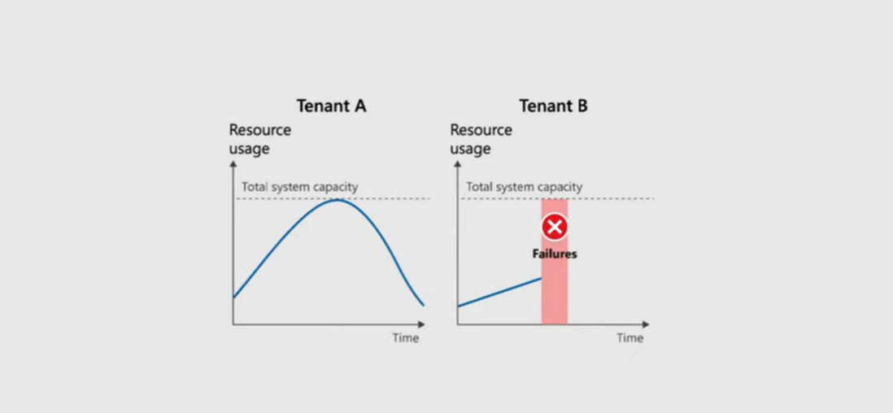
Noisy neighbors

Slide 36
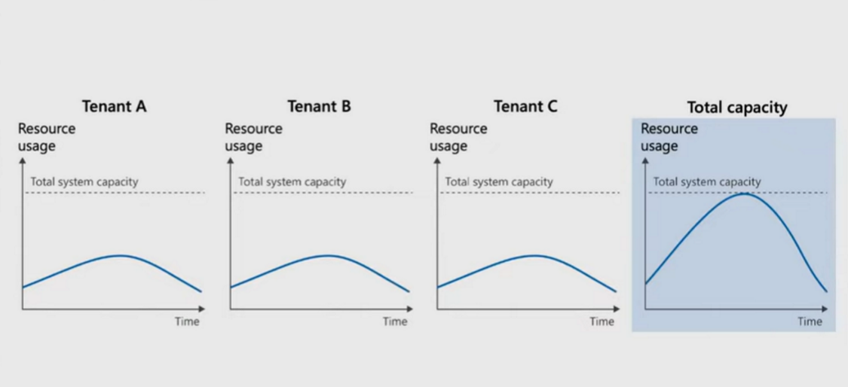
Noisy neighbors

Slide 37
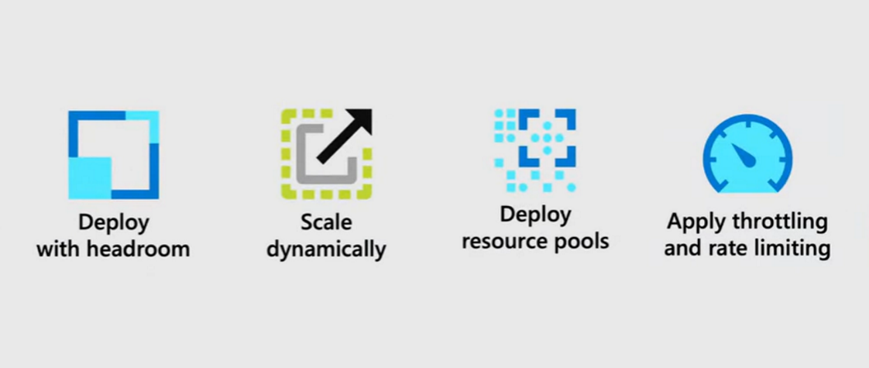
Noisy neighbor mitigations

Slide 38
Noisy neighbor mitigations
Actions we can take for our SaaS solution:
Split tenant out into their own database
Move tenant to another SQL Elastic Pool
Notes:
Here are some specific actions we can take for our SaaS solution

Slide 39
DEMO: Pool management
Azure SQL, Elastic SQL Pools

Slide 40
Call to action
Understand the tenant’s requirements.
Understand the business model and requirements.
Consider the tradeoffs of each multitenancy isolation model.
Review Azure guidance to design and implement multitenancy.

Slide 41
References
Building scalable cloud databases - Azure SQL Database | Microsoft Learn
Multi-tenant SaaS patterns - Azure SQL Database | Microsoft Learn
Scale out a database - Azure SQL Database | Microsoft Learn
Map requests to tenants in a multitenant solution - Azure Architecture Center | Microsoft Learn
Architectural considerations for a multitenant solution - Azure Architecture Center | Microsoft Learn
Azure resource organization in multitenant solutions - Azure Architecture Center | Microsoft Learn
Multitenancy checklist on Azure - Azure Architecture Center | Microsoft Learn
Architectural approaches for the deployment and configuration of multitenant solutions - Azure Architecture Center | Microsoft Learn
Moving data between scaled-out cloud databases - Azure SQL Database | Microsoft Learn
https://aka.ms/multitenancy
https://aka.ms/azurelimits

Slide 42




Let’s connect
Callon@CloudMavericks.ca
@Flying_Maverick
https://LinkedIn.com/in/CallonCampbell
https://GitHub.com/CallonCampbell

